Slide 1
Object Oriented Analysis and Design
Introduction
COMP 3831
Craig Larman: Chapters 1,2,3
W1L1 Introduction to OOAD
COMP 3831 OOA&D

Slide 2
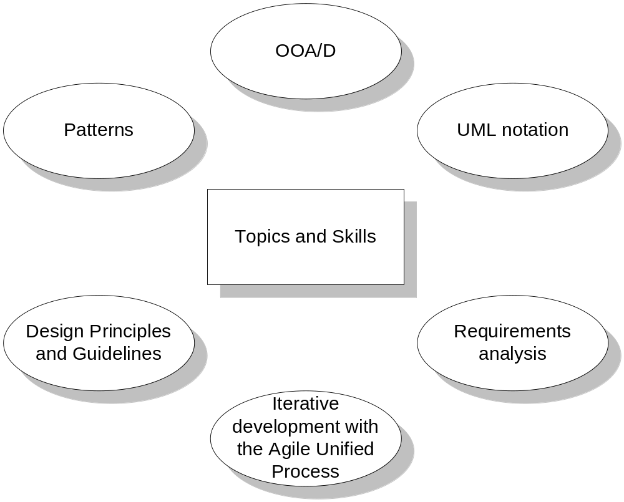
Topics and Skills covered
W1L1 Introduction to OOAD
COMP 3831 OOA&D

Slide 3
What is the course about?
Learn how to “think in objects”
Analyze the Requirements of the problem domain
Design a solution
  Assign responsibilities to objects
  Design patterns
Do Iterative Development following the Agile Unified Process
AGILE = LIGHT + FLEXIBLE
Learn UML 2 notation
Apply best Principles and Guidelines
Learn basic concepts of Quality Assurance
Gain Hands On experience with the above
W1L1 Introduction to OOAD
COMP 3831 OOA&D

Slide 4
Unified Modeling Language (UML)
Visual Language for
    Specifying
    Constructing
    Documenting
    the artifacts of a system
Notation used to record analysis and design
W1L1 Introduction to OOAD
COMP 3831 OOA&D

Slide 5
Agile Modeling
Tools don’t compensate for bad design
We need to gain good OO design and programming skills
Over Analyzing and Designing - Death by UML Fever
Agile Modeling - uses UML as sketch
Agile Modeling - key to effective UML
W1L1 Introduction to OOAD
COMP 3831 OOA&D

Slide 6
Patterns
What are Design Patterns?
  Certain tried-and-true solutions to design problems that can be expressed by both:
      - The Design problem
      - The Good design solution for the problem, in a given context
W1L1 Introduction to OOAD
COMP 3831 OOA&D

Slide 7
The Dice Game example
W1L1 Introduction to OOAD
COMP 3831 OOA&D

Slide 8
1. Define Use Cases
Play a Dice Game - Player requests to roll the dice. The System presents results: If the dice face totals seven, player wins; otherwise player loses
Define Use Cases
Define Domain Model
Define Interaction Diagrams
Define Design Class Diagrams
Requirements Analysis identifies stories or scenarios of how people use the application
Use Cases are stories written in a specific format
Use Cases are not an OO artifact
W1L1 Introduction to OOAD
COMP 3831 OOA&D

Slide 9
2. Define a Domain Model
Object Oriented Analysis defines the domain model that shows all the noteworthy domain concepts: Player, Die and DiceGame with their associations and attributes.
Define Use Cases
Define Domain Model
Define Interaction Diagrams
Define Design Class Diagrams
Player
1
Rolls
2
Die
name
faceValue
1
2
Plays
1
DiceGame
1
Includes
W1L1 Introduction to OOAD
COMP 3831 OOA&D

Slide 10
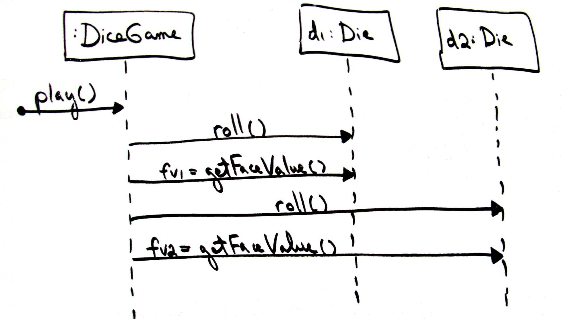
3. Assign Object Responsibilities and Draw Interaction Diagrams
Sequence Diagrams show messages between software objects
Define Use Cases
Define Domain Model
Define Interaction Diagrams
Define Design Class Diagrams
W1L1 Introduction to OOAD
COMP 3831 OOA&D

Slide 11
4. Define Design Class Diagrams
Class Diagrams show a static view of the class definitions with their relationships, attributes and methods.
Define Use Cases
Define Domain Model
Define Interaction Diagrams
Define Design Class Diagrams
DiceGame
Die
die
1
:
Die
1
2
faceValue
:
int
die
2
:
Die
getFaceValue
() :
int
play
()
roll
()
W1L1 Introduction to OOAD
COMP 3831 OOA&D

Slide 12
Why OOA&D?
Development time will be the same or even longer than using functional means
Historically object oriented environments have been associated with slower execution
W1L1 Introduction to OOAD
COMP 3831 OOA&D

Slide 13
One Really Good Reason to Use OOA&D
Allows the construction of a "clear" picture of a complex system.
Facilitates the construction of systems that are easier to:
  Understand
  Maintain
  Extend
W1L1 Introduction to OOAD
COMP 3831 OOA&D

Slide 14
Purposes of Analysis and Design
To transform the requirements into a design of the system to-be.
To evolve a robust architecture for the system.
To adapt the design to match the implementation environment, designing it for performance.
W1L1 Introduction to OOAD
COMP 3831 OOA&D

Slide 15
Analysis (What?)
Build the model of a real world situation
Show important properties
No implementation concepts or decisions
No clear cut division between analysis and design
Analysis
Design
W1L1 Introduction to OOAD
COMP 3831 OOA&D

Slide 16
Design (How?)
Design model based on the analysis model
Implementation details added
Data structures and algorithms
Analysis classes gain implementation details
W1L1 Introduction to OOAD
COMP 3831 OOA&D

Slide 17
Analysis Versus Design
Analysis
  Focus on understanding the problem
  Capture the Behavior
  Understand the System structure, parts
  Write the Functional Requirements
  Create a small model
Design
  Focus on understanding the solution
  Identify Operations and Attributes
  Address Performance
  Design is close to the real code
  Include Non-functional requirements
  Create the large model
W1L1 Introduction to OOAD
COMP 3831 OOA&D
Notes:
An instructor once said: “Analysis Vs. Design is important because of the mind-set. If you tried to manage all of the analysis and design issues in one go, your brain would explode on all but the most trivial developments. It’s just too much to take in, comprehend, and model in one go. So I mentally switch “OK, analysis - problem domain - don’t care about memory, persistence, databases, language, etc”. “Right now it’s design and I do care about all those things - but now I can stop thinking (too a degree) about trying to understand the business domain.” It’s about managing the 7+/-2 things I can think about in one go. It also separates out the skills (a bit).”
Another instructor once said: “analysis is the study of and eventual comprehension of “some thing” [the problem space]. But to understand it, we must invent some entities to hold onto the thing that we have just grasped - this inventive process is design. That is, human cognitive thinking is actually interwoven analysis/design and any attempt to separate them is really only an idealization. Therefore, if I try to apply two separate “steps” in the production of, say, a class diagram [and call those steps A and then D], I will introduce ambiguity into my process because cognitive process forces one to “produce a solution” in order to “understand a problem” - that D is necessary to have any results from A.”
Think of analysis as an idealized design step - where we ignore several complicating issues. This can turn into a religious debate.
The differences between analysis and design are ones of focus and emphasis. The above slide lists the things that you focus on in analysis versus design.
The goal in Analysis is to understand the problem and to begin to develop a visual model of what you are trying to build, independent of implementation and technology concerns. Analysis focuses on translating the functional requirements into software concepts. The idea is to get a rough cut at the objects that comprise our system, but focusing on behavior (and therefore encapsulation). We then move very quickly, nearly seamlessly into “design” and the other concerns.
A goal of design is to refine the model with the intention of developing a design model that will allow a seamless transition to the coding phase. In design, we adapt to the implementation and the deployment environment. The implementation environment is the 'developer' environment, which is a software superset and a hardware subset of the deployment environment
In modeling, we start with an object model that closely resembles the real world (analysis), and then find more abstract (but more fundamental) solutions to a more generalized problem (design). The real power of software design is that it can create more powerful metaphors for the real world which change the nature of the problem, making it easier to solve.

Slide 18
Why Modeling?
Test before you build
Better Communication
Visualization
Break down complexity
Manage risks
  All abstractions are incomplete and inaccurate
  Different models can be made of the same system
W1L1 Introduction to OOAD
COMP 3831 OOA&D

Slide 19

Object-orientation - identify and represent the objects in the business domain
Example: A Flight Information System
Plane
visualization of
domain concept
tailNumber
domain concept
public class Plane
representation in an
{
object
-
oriented
private String tailNumber
;
programming language
public List getFlightHistory
()
{
...
}
}
W1L1 Introduction to OOAD
COMP 3831 OOA&D

Slide 20
Four Major Principles of OO
Abstraction | The essential characteristics of an entity that distinguish it from all other kind of entities and thus provide crisply-defined boundaries relative to the perspective of the viewer.
Encapsulation | The physical localization of features (e.g., properties, behaviors) into a single black box abstraction that hides their implementation (and associated design decisions) behind a public interface. Encapsulation is also referred to as information hiding
Polymorphism | Polymorphism is the ability to define a single interface with multiple implementations.
Inheritance | The mechanism that makes generalization possible; a mechanism for creating a new class using an existing classes as a foundation.
W1L1 Introduction to OOAD
COMP 3831 OOA&D

Slide 21
Questions
W1L1 Introduction to OOAD
COMP 3831 OOA&D

Slide 22
Iterative, Evolutionary, and Agile
W1L1 Introduction to OOAD
COMP 3831 OOA&D

Slide 23
Software Development Process
Describes an approach to building, deploying, and maintaining software
Software engineering is the profession that creates and maintains software applications by applying technologies and practices from computer science, project management, engineering, application domains, and other fields.
Find repeatable, predictable processes or methodologies that improve productivity and quality.
W1L1 Introduction to OOAD
COMP 3831 OOA&D

Slide 24
Steps in Software Development Process
Requirements Analysis
Extracting the requirements of a desired software product may require skill and experience to recognize incomplete, ambiguous or contradictory requirements.
Specifications is the task of precisely describing the software to be written. Specifications are most important for external interfaces, that must remain stable.
Specifications
Design and Architecture
Design and architecture refer to determining how software is to function in a general way without being involved in details. Usually this phase is divided into two sub-phases.
Reducing a design to code may be the most obvious part of the software development job, but it is not necessarily the largest portion.
Coding
Testing
Testing of parts of software, especially where code by two different programmers must work together.
An important (and often overlooked) task is documenting the internal design of software for the purpose of future maintenance and enhancement. Documentation is most important for external interfaces.
Documentation
Maintenance
Maintaining and enhancing software to cope with newly discovered problems or new requirements. This can take far more time than the initial development of the software.
W1L1 Introduction to OOAD
COMP 3831 OOA&D

Slide 25
Types of Software Development Process
Waterfall Processes
The best-known and oldest process is the waterfall model, where developers follow the steps in order.
Development is organized into a series of short, fixed-length mini-projects called iterations. The outcome of each is a tested, integrated and executable partial system.
Iterative Processes
Agile processes are built on the foundation of iterative development by adding a more people-centric viewpoint than traditional approaches. Agile processes use feedback, rather than planning, as their primary control mechanism.
Agile Processes
W1L1 Introduction to OOAD
COMP 3831 OOA&D

Slide 26
Iterative, Incremental and Evolutionary Development
Iterations = Short, fixed-length mini-projects
    Repeating cycles
    Early programming
    Early testing
System grows incrementally
Feedback to evolve the specifications and design
W1L1 Introduction to OOAD
COMP 3831 OOA&D

Slide 27
Iterative Diagram
Requirements
Requirements
Feedback from
iteration N leads to
Design
Time
Design
refinement and
adaptation of the
Implementation
&
Implementation
&
requirements and
Test
&
Integration
Test
&
Integration
design in iteration
&
More Design
&
More Design
N
+
1
.
Final Integration
Final Integration
&
System Test
&
System Test
3
weeks
(
for example
)
Iterations are fixed in
The system grows
length
,
or
timeboxed
.
incrementally
.
W1L1 Introduction to OOAD
COMP 3831 OOA&D

Slide 28
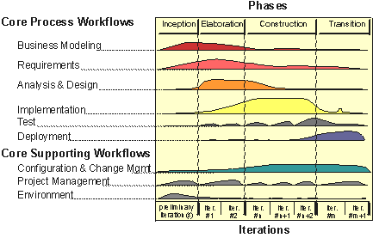
The Unified Process (UP) – The Humpback Chart
W1L1 Introduction to OOAD
COMP 3831 OOA&D

Slide 29
UP Phases
A RUP Lifecycle consists of 4 Phases
Every Phase has one or more iterations
An Iteration is like a mini waterfall complete development cycle
Inception
Elaboration
Construction
Transition
Identify the Objective
Create Business Case
Establish Project Management Infrastructure
Detail Design
Establish a project plan and a sound architecture
Write and grow the software
Deliver the System to the users
W1L1 Introduction to OOAD
COMP 3831 OOA&D

Slide 30
Disciplines and Artifacts
Discipline = set of activities and the related artifacts in one subject area
Artifact = any work product or deliverables: code, Web graphics, database schema, text documents, diagrams, models, etc.
Rational Unified Process provides a complete set of Artifacts (template and guide) for each Discipline, within each Phase
W1L1 Introduction to OOAD
COMP 3831 OOA&D

Slide 31
Waterfall Errors and UP Benefits
Waterfall is based on two very inaccurate assumptions:
  We can freeze requirements
  We can get the design right on paper before proceeding to the next step.
Unified Process benefits
  Risks are addressed early
  Change is more manageable
  Higher opportunity for reuse
  Latitude for learning and improvement
  Team focused on outcome
W1L1 Introduction to OOAD
COMP 3831 OOA&D

Slide 32
Iteration Time-boxing
Iteration length between 2 to 6 weeks
Small steps, rapid feedback, adaptation
The result of each iteration is an executable system, may not be ready for production deployment
Iteration
Iteration
...
1
2
2 weeks
2 weeks
Analyze
Design
Code, Test,
Analyze
Design
Code, Test,
Integrate
Integrate
W1L1 Introduction to OOAD
COMP 3831 OOA&D

Slide 33
Risk-Driven, Client-Driven,
Iterative Planning
Goals of early iterations
High risks or unknowns
High business value
Core architecture
Paticipants in Requirements Workshops and Iteration Planning meetings
Business People
Development People
Chief Architect
W1L1 Introduction to OOAD
COMP 3831 OOA&D

Slide 34
Agile Development = Rapid + Flexible
Iterative, Evolutionary and Timeboxed Development
Incremental delivery
Adaptive planning
Work value
Simplicity
Lightness
Team value
Communication
Self-organizing teams
W1L1 Introduction to OOAD
COMP 3831 OOA&D

Slide 35
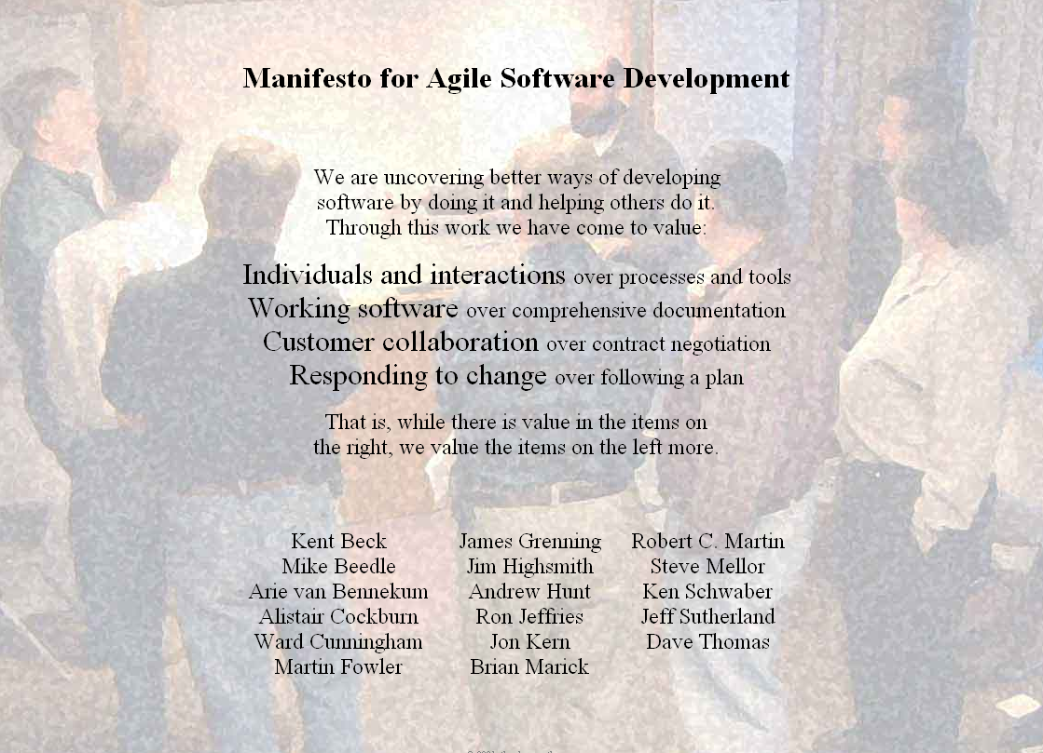
Manifesto for Agile Software Development
W1L1 Introduction to OOAD
COMP 3831 OOA&D

Slide 36
Agile Development Principles (1)
Our highest priority is to satisfy the customer through early and continuous delivery of valuable software.
Welcome changing requirements, even late in development. Agile processes harness change for the customer's competitive advantage.
Deliver working software frequently, from a couple of weeks to a couple of months, with a preference to the shorter timescale.
W1L1 Introduction to OOAD
COMP 3831 OOA&D

Slide 37
Agile Development Principles (2)
Business people and developers must work together daily throughout the project.
Build projects around motivated individuals. Give them the environment and support they need, and trust them to get the job done.
The most efficient and effective method of conveying information to and within a development team is face-to-face conversation.
W1L1 Introduction to OOAD
COMP 3831 OOA&D

Slide 38
Agile Development Principles (3)
Working software is the primary measure of progress.
Agile processes promote sustainable development. The sponsors, developers, and users should be able to maintain a constant pace indefinitely.
Continuous attention to technical excellence and good design enhances agility.
W1L1 Introduction to OOAD
COMP 3831 OOA&D

Slide 39
Agile Development Principles (4)
Simplicity--the art of maximizing the amount of work not done--is essential.
The best architectures, requirements, and designs emerge from self-organizing teams.
At regular intervals, the team reflects on how to become more effective, then tunes and adjusts its behavior accordingly.
W1L1 Introduction to OOAD
COMP 3831 OOA&D

Slide 40
Questions and Conclusions
W1L1 Introduction to OOAD
COMP 3831 OOA&D

